Slide 1
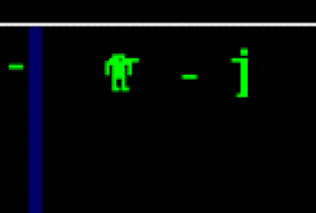
Berzerk

Slide 3
Your boss LOVES Berzerk!
Multi-player
You can upgrade you gun to a heat seeking missile
You drop your “regular” ray-gun, you pick up the missile launcher
You also have to pick up rockets
The robots can also pick up the rocket launcher (once they see you shoot it)
You can get roller skates (to go faster)
If you are hit once, then your skates fall off
Also there are stronger robots sometimes.

Slide 4
Inheritance: “Is a”
If an object “is a” type of another object, then use inheritance
RayGun “is a” weapon
MissleLanucher “is a” weapon
AVOID: “has a” relationships

Slide 5
cRayGun:
std::string colour;
Shoot();
cWeapon:
glm::vec2 position;
glm::vec2 velocity;
bool isShot;
Int shoesize;
Shoot();

Slide 6
cRayGun:
std::string colour;
Shoot();
vTable()
cRayGun:::Shoot()
cWeapon::shoot()
cWeapon:glm::vec2 position;
glm::vec2 velocity;
bool isShot;
Int shoesize;
Shoot();

Slide 7
C++ inheritance
class is default “private” (unlike struct which is default public)
“public” means it’s exposed externally:
Methods can be called
Variables are exposed for read & write
“private” means it’s completely hidden outside the class
Note that these items are still “seen” by the rest of the code, in that any change to the header file will force a rebuild.
You can also just see the code in the header.

Slide 8
C++ inheritance
There is also “protected” which is only used when one class “inherits” from another. Anything “protected” (methods or variables) are visible “parent” or “derived” class as a “private” variable.
Any classes “further down” the inheritance chain also have these.
This is because derived classes literally have the base classes
i.e. they aren’t copied or something like that, it means that if you create a parent/derived class, then the base class is also created.

Slide 9
C++ inheritance is indented for code re-use
You inherit from a class so you don’t have to duplicate code
This avoids making mistakes when there’s an update.
ONLY use inheritance when the parent/derived class “is a” type of the base class, NOT that it has some capability.
cDog that has a base class of cAnimal == GOOD
A “cDog” *IS AN* “cAnimal”
cDog that has a base class of cBall == VERY BAD
A “cDog” *HAS A* or *USES A* “cBall”
This was very common with Java and older languages, but over time, it became clear that this is a really, really bad idea.

